Slide 1
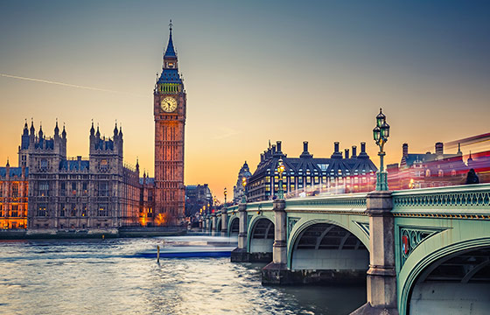
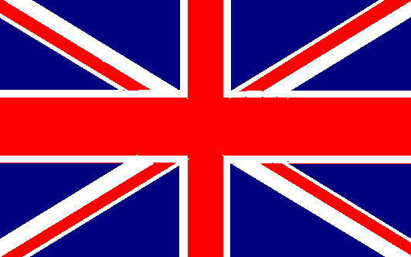

Intercultural Communication
Yueh-chiu Wang, associate professor at National Penghu University of Science and Technology

Slide 2
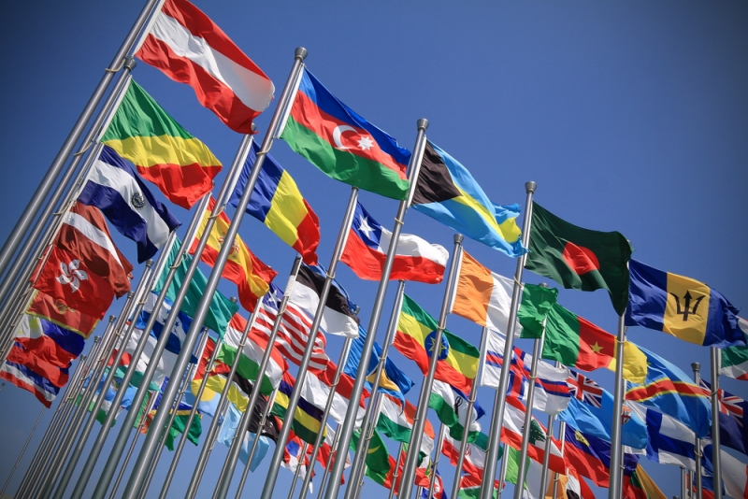
CONTENTS
06
British Educational System
01
07
The theories of cross-cultural communication
British society: housing, class and race
02
08
The United Kingdom
Land, people and history in Australia
03
09
The UK Economy
Cultural and social life in Australia
04
British Literature
10
Land, people and history in New Zealand
05
British Holidays and Festivals

Slide 3
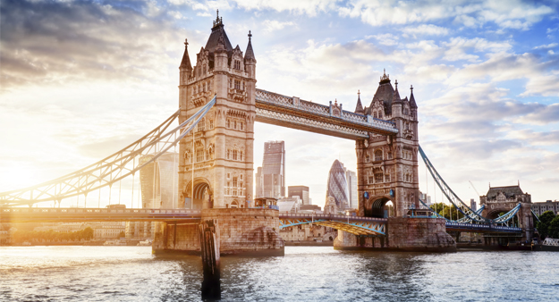
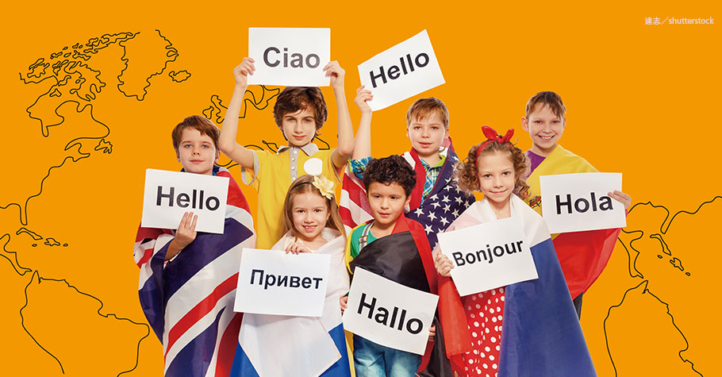
Chapter 1
The theories of cross-cultural communication

Slide 4
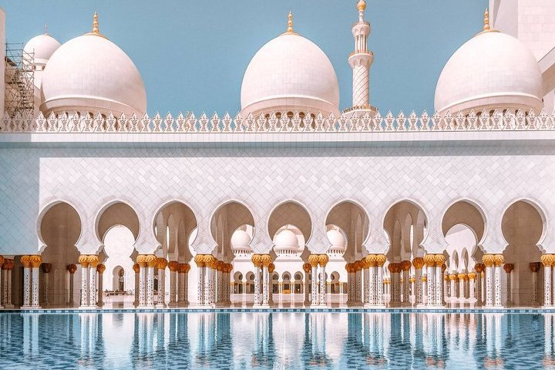
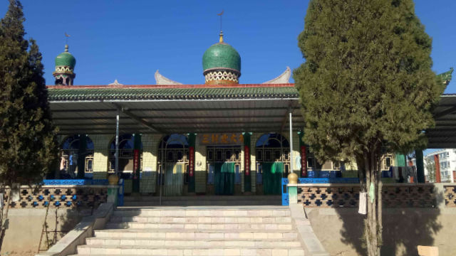
Take it off or put it on
Shoes are among the biggest offenders in the East, even if you war a 5AAA. They are forbidden within Muslim mosques and Buddhist temples. Never wear them into Japanese homes or restaurants unless the owner insists. And in Indian and Indonesian homes, if the host goes shoeless, do likewise.

Slide 5

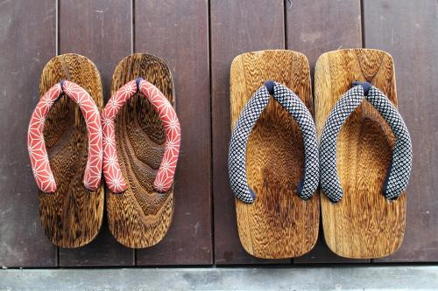
Wherever you take your shoes off, remember to place them neatly together facing the door you came in. This is particularly important in Japan.

Slide 6
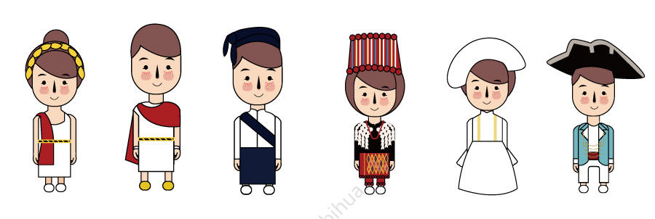
Dress
In the Philippines men wear the barong tagalog—a loose, frilly, usually white or cream-colored shirt with no jacket or tie. In Indonesia they wear batiks—brightly patterned shirts that go tieless and jacketless Thai silk shirt. In Japan dress is at least as formal as in Europe (dark suit and tie for a man, business suit or tailored dress for a woman.

Slide 7


Religion and Sex: Protocol at Its Pinnacle
Religion is often an important part of a culture (e.g., the Middle East) and therefore an unavoidable adjunct to business or tourist travel. As for sex, while Americans are slowly learning to change their vocabulary from businessman to businessperson.

Slide 8
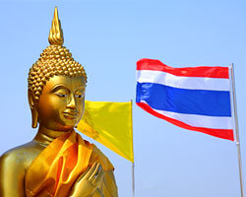

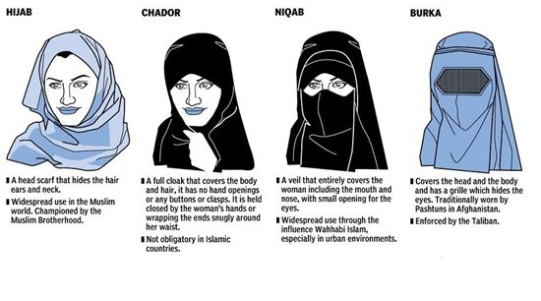
Where religion is a religion
All Buddhist images, even the famous tourist sites, are holy and never to be photographed without permission. Doorsills must never be stepped on, for Thais believe that kindly sprits dwell below.
In Muslim countries, proper dress and proper decorum between the sexes are as important as observing any civil laws.

Slide 9
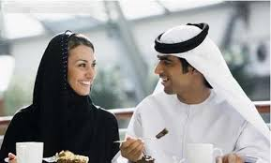
In Britain and Western Europe a few women have risen or are rising through the ranks. Even today women are forbidden to drive cars or ride bicycles in Saudi Arabia. Even if an Arab invites your home, his wife will probably not be seen. On the other hand, when the same Arab businessman comes to your country, his wife just may accompany him and then she should receive all the courtesies of any Western woman.

Slide 10
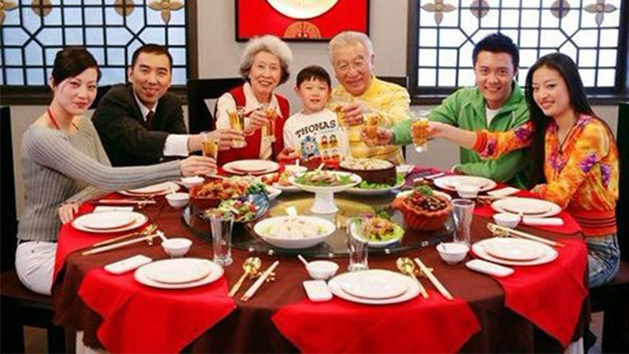
Whether you are a man or a woman, it is advisable to mention your family life as assurance of your stability as a business associate. In Eastern cultures family ties are extremely important.

Slide 11
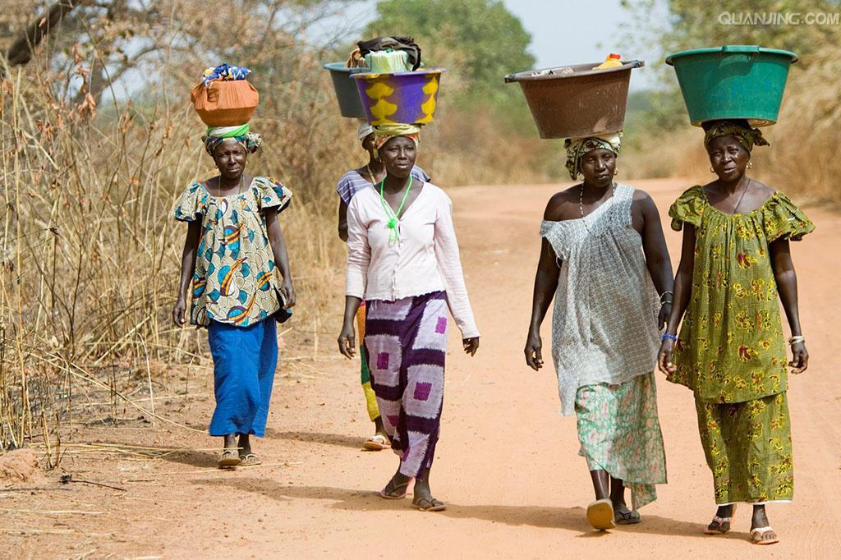
Women also have a strong role in Africa, both in home and in business. Yet visitors should remember that in Muslim and Buddhist-nations, the religious stricture against mixing the sexes socially still obtains.

Slide 12
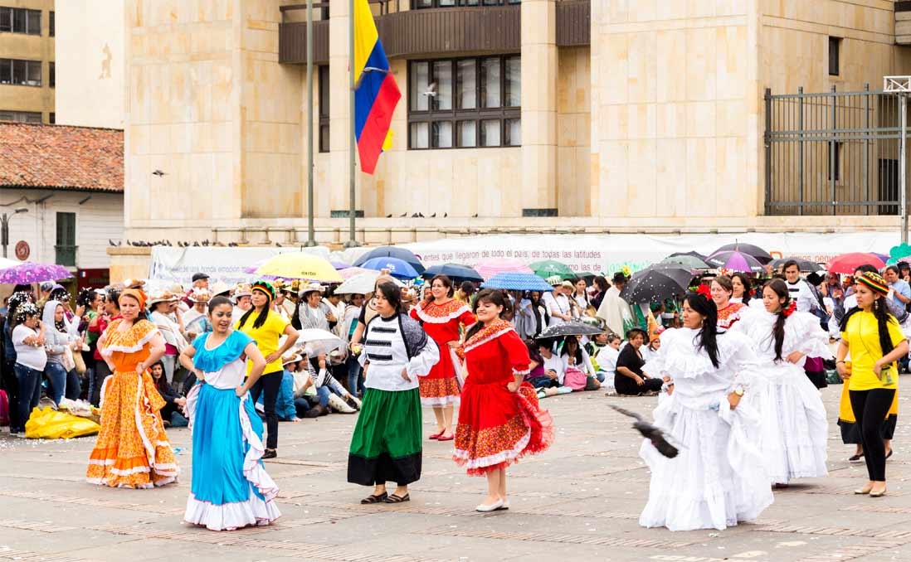
CC
In Latin America as well, women are smoothly accepted into business and governmental hierarchies. But in a land where machismo is every man’s birthright, it does not pay to come on like Sueprwoman.

Slide 13
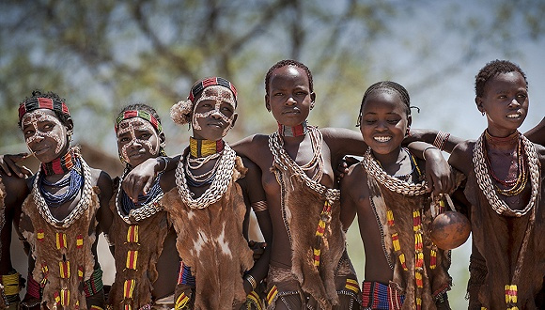
In Latin America as well, women are smoothly accepted into business and governmental hierarchies. At presentations, sales meetings, even in personal conversations—particularly when the woman speaking outranks any men present—it is useful to avoid a lot of “I did”s and “I know”s in favor of At our company we found that …”.

Slide 14


After-hours etiquette
Never risk losing your credentials as a serious businesswoman by what you do after business. In Western European countries this is almost never an issue. But elsewhere it is easy to raise eyebrows—and lower your prestige.

Slide 15
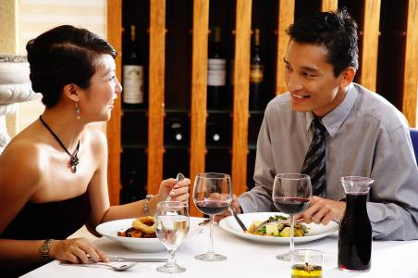

1. Avoid eating or drinking alone in restaurants that the local or business travelers use to pick up women.
2. Unless it comes from your company, do not give male colleagues any but the most perfunctory gift unless obviously earmarked for the home or children.

Slide 16
3. If you are married, use a Mrs. Even if you don’t at home.
4. As soon as you are introduced to the family, stop talking business and strike up a rapport with the others.

Slide 17
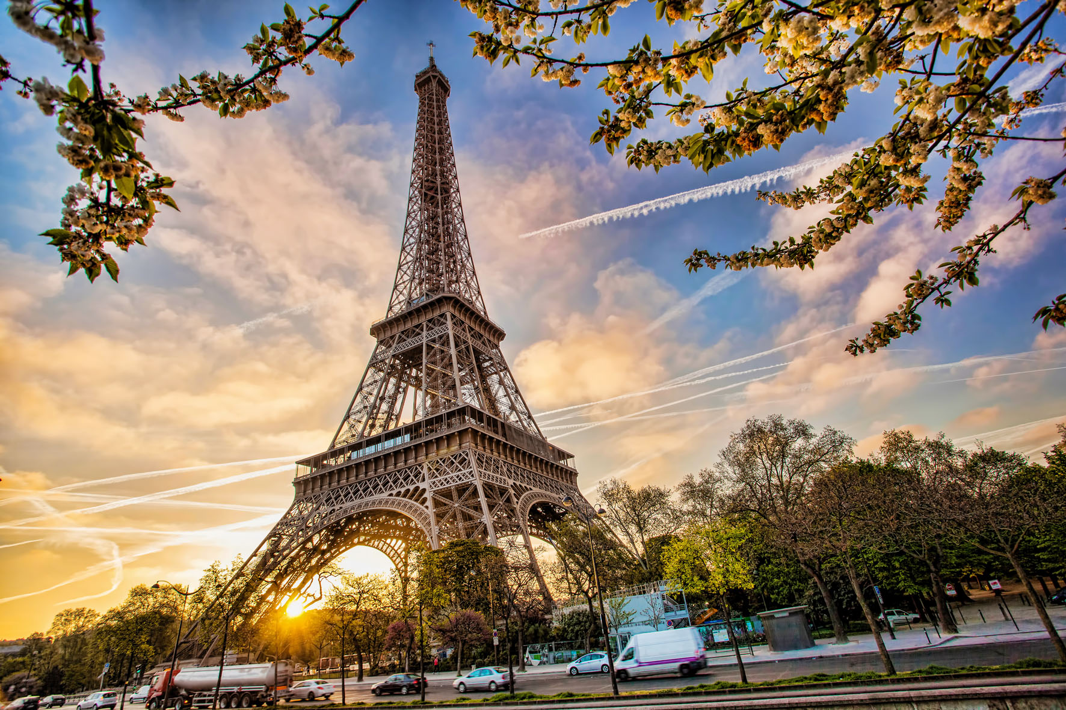

The French are proud of their education and their opinions. They get right down to business matters but are slow to come to decisions, displaying a seemingly endless fascination with minute details. Whether the decision is good news or bad, they state their intentions unambiguously.

Slide 18
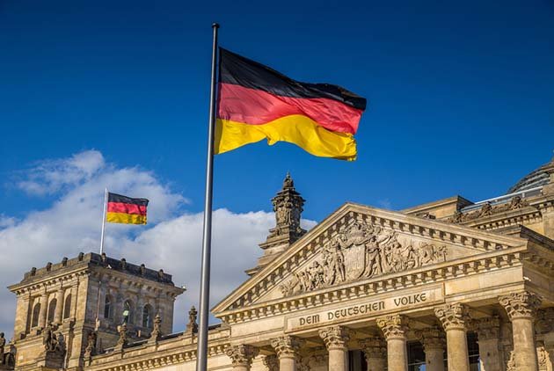

In Germany, gentlemen walk and sit to the left of all ladies and men of senior business rank. Men rise when a woman leaves or returns to the table. Formality and punctiliousness are more pronounced here than anywhere else in Europe.

Slide 19
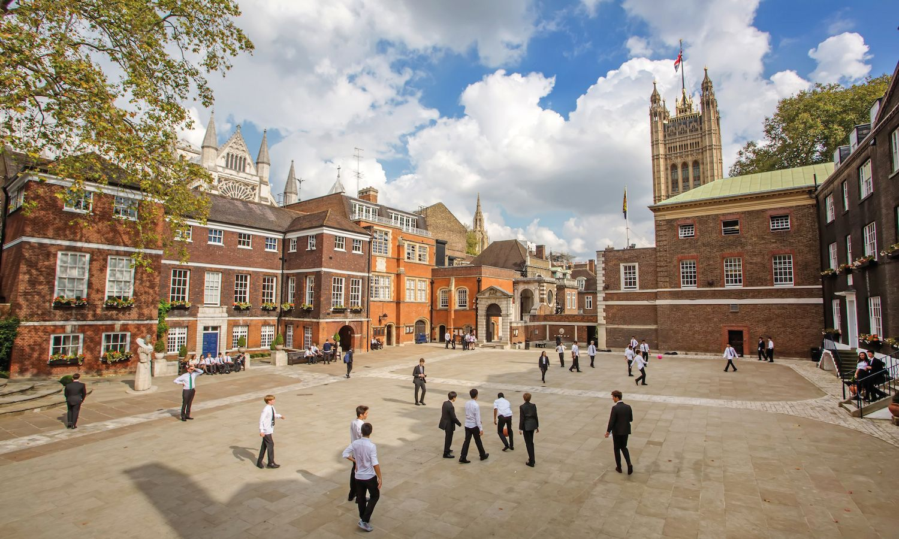
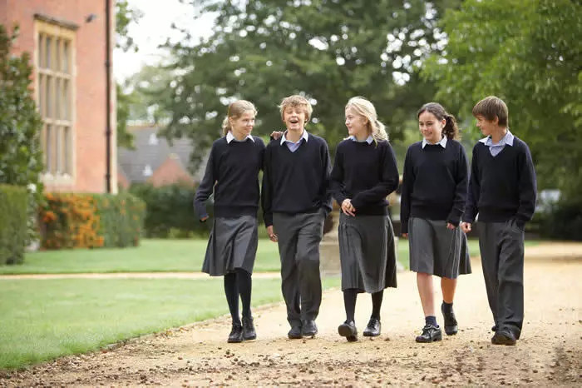
In Great Britain, the British public school specializes in manners and self-discipline. In business, emotions are rarely vented and protocol (agreement) is given the utmost attention. In socializing, be sure to issue your invitations well in advance.

Slide 20

Most honorary titles such as sir, dame, and lord are used even among familiar acquaintances.
In pubs the change you leave on the counter for your next drink may be taken as a tip by the bartender.

Slide 21
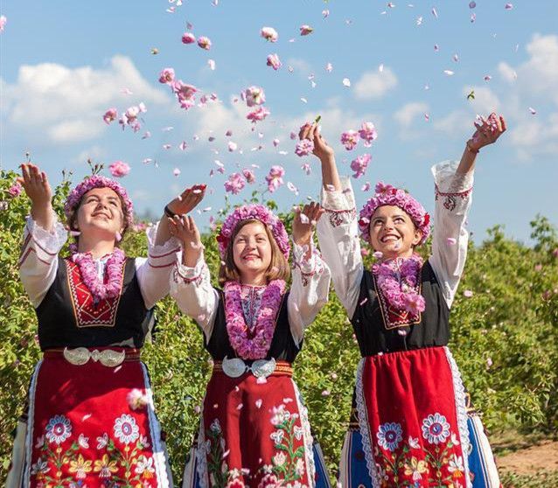

In Bulgaria, a nod means no and a shake of the head means yes.
In both Denmark and Sweden, the toast can be a very formal regimen. You must never toast your host or anyone senior to you in rank or age until they toast you, nor must you touch your drink.

Slide 22
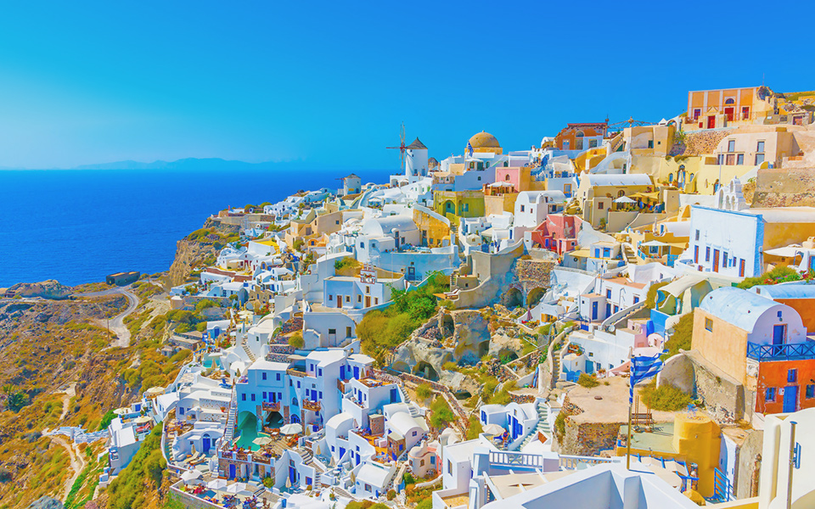
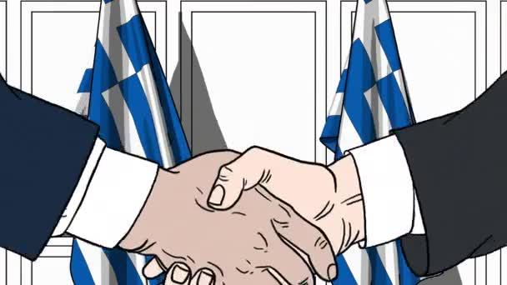
In Greece, there are no rules of greeting; they may shake hands, embrace, and or kiss at the first and every meeting. Punctuality is not a must.

Slide 23


In Italy, handshaking is a national pastime, but seldom do Italians remember names on first introduction.
In the Netherlands, the toast is given just before and just after the first sip. Punctuality is a must.

Slide 24
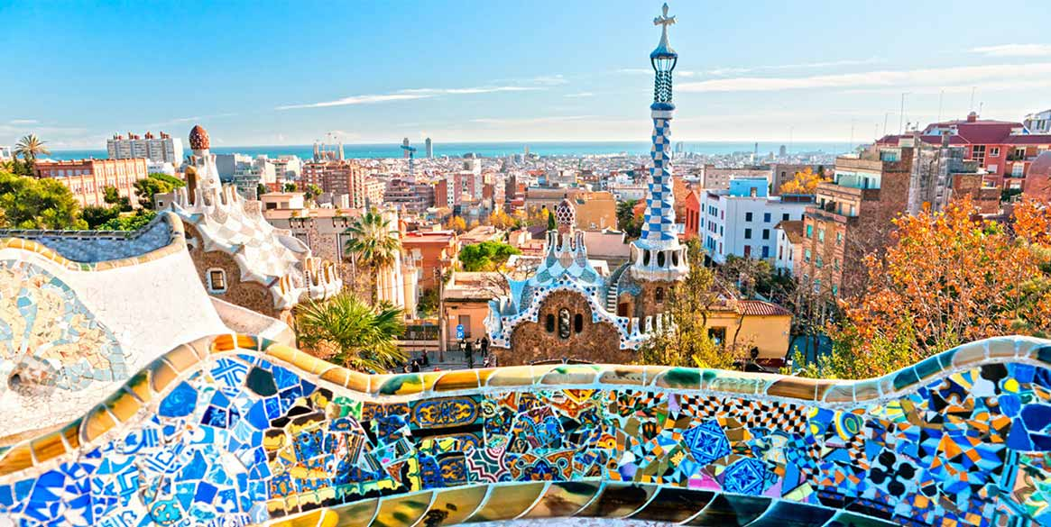
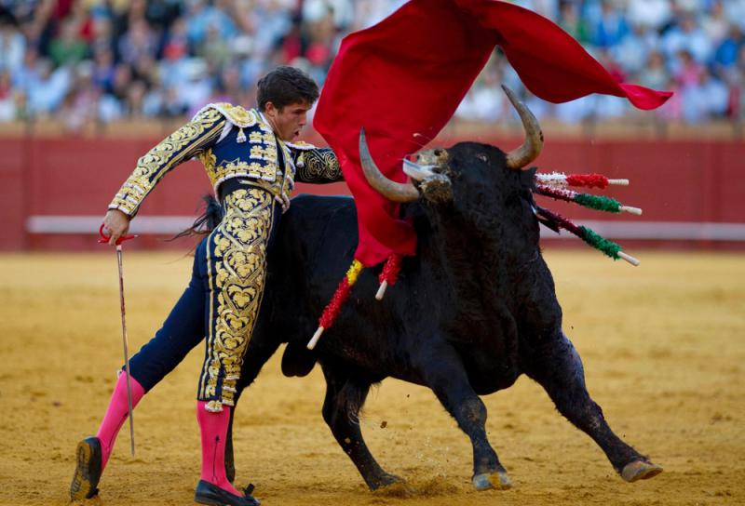
In Spain, the only time you must take punctuality seriously is when attending a bullfight. Most offices and shops close for siesta all the way from 1:30 to 4:30 p.m. and restaurants do not usually reopen until after 9 or get into full swing until 11.

Slide 25
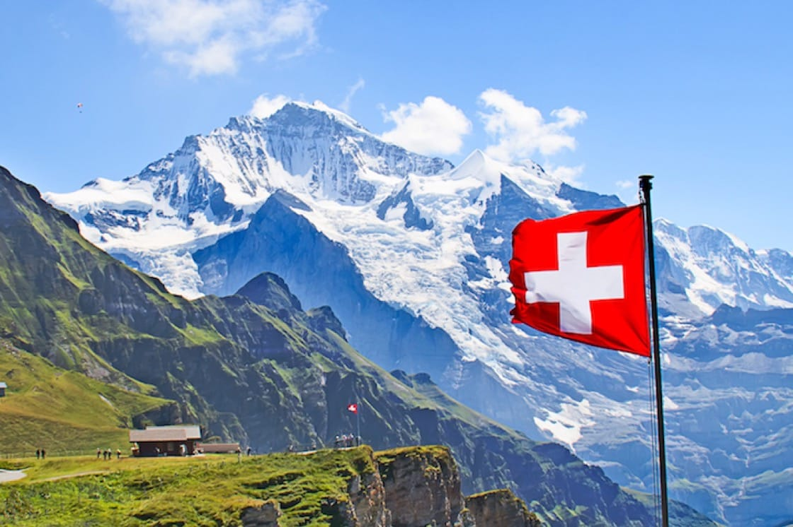
In Switzerland, punctuality is a way of life.
Handshakes are the custom outside the home, but a host may welcome you with a kiss on both cheeks and you should reciprocate. Do not ask for an alcoholic drink unless it is offered, and do not bring the hostess a gift or inquire about her.

Slide 26
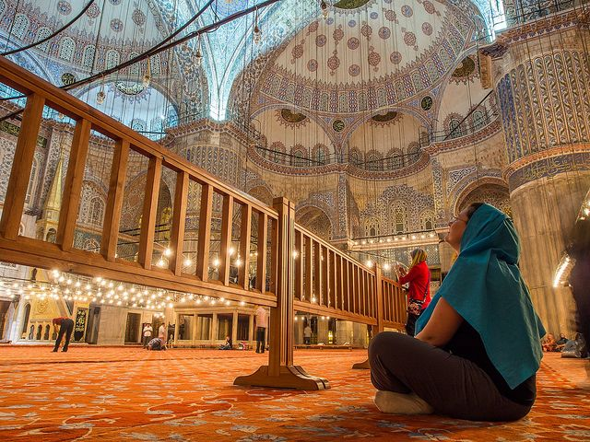
It is important to arrive at both social and business affairs on time. But do not expect to leave them on time. Pork is also forbidden. Any animal that scavenges or has a cloven hoof is shunned by devout Muslims.

Slide 27
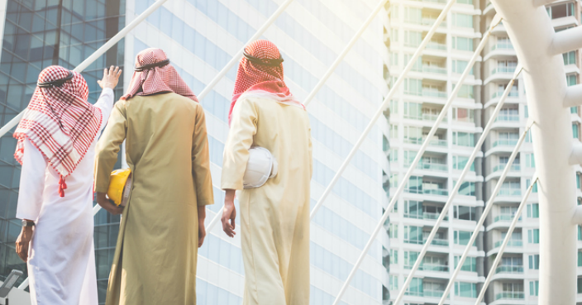
In Saudi Arabia, greetings are particularly elaborate: first, you say salaam alaykum; second, you shake hands, accompanied by the words kaif halak; next, a Saudi will often extend his left hand to your right shoulder and kiss you on both cheeks.

Slide 28
Putting a good face on even the worst situation remains a way of life even in Hong Kong and Singapore, where the English have introduced an equal dose of Westernization.

Slide 29
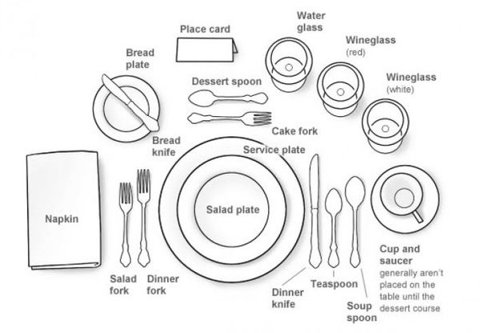

In Malaysia, for instance, you will be given chopsticks and a spoon when dining with a Chinese, but if your host is a Hindu or Malay, you may get nothing at all. Your hands are your utensils for the evening. Pork is a staple of Chinese cooking, but Malays will not touch it. On the other hand, Hindus and Buddhists avoid beef.

Slide 30

Buddhists are also extremely sensitive about being touched on the head, especially in Thailand. While the handshake takes precedence over any other greeting in most Oriental countries (except Japan), Thais still prefer the Wai, which is executed by placing both hands together in a praying position at the chest.

Slide 31
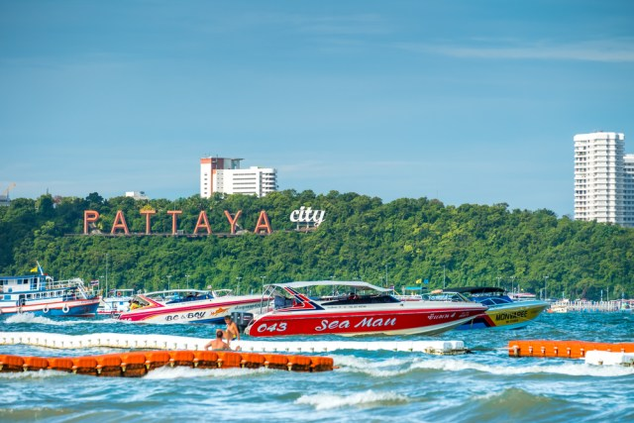
The higher the hands, the more respect you show. When shopping in Thailand, remember that except in department stores and bookstores, prices are merely an invitation to bargain and may be anywhere from 100 to 300 percent higher than the seller is willing to accept after vigorous haggling.

Slide 32
In India, Muslim women are kept from the view of men outside their families, and even non-Muslim women seldom show up at social functions or sit at the dinner table or join in the conversation even in their homes. That red dot on the forehead or hair usually a woman is married.

Slide 33
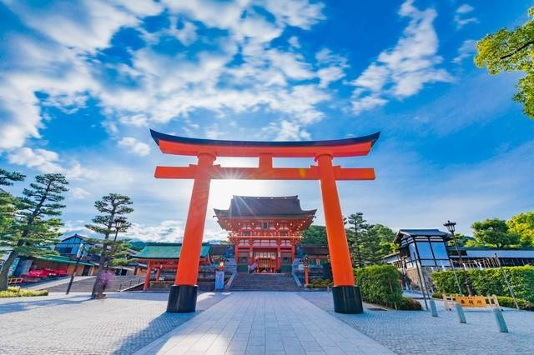

In Japan, they never say no in public, which is why American businessmen often take away the wrong impression. But this obsession with pleasing does not mean that the Japanese make quick friends, particularly with Western businesspeople.

Slide 34
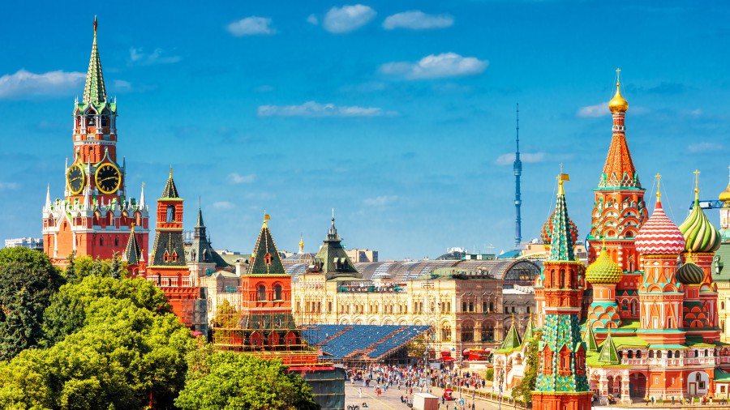
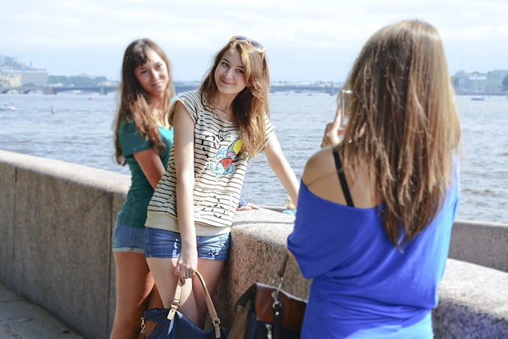
In Russia, there is no oriental-style masking of emotions and keeping you cool. Expansiveness, generosity, and letting go are everything. Since democratization and the move to a market economy, you may take gifts for your Russian business acquaintances.

Slide 35
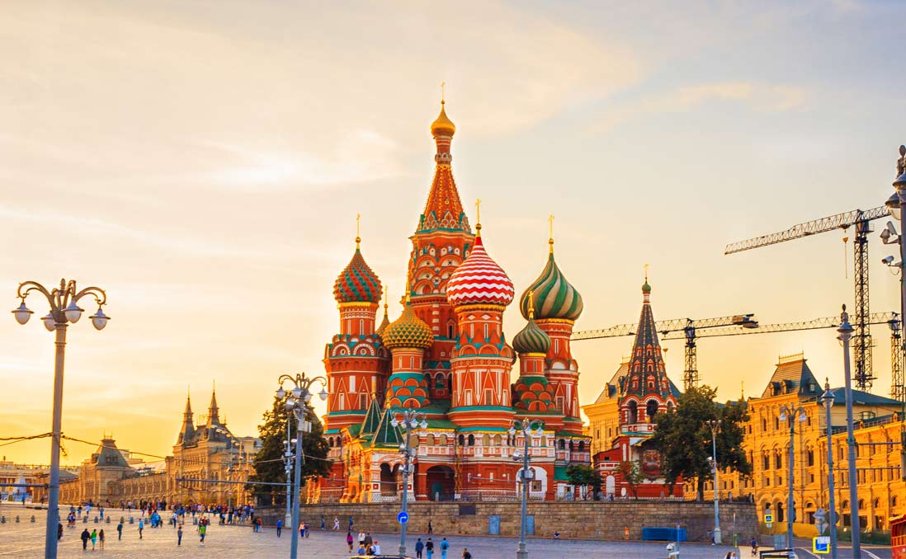
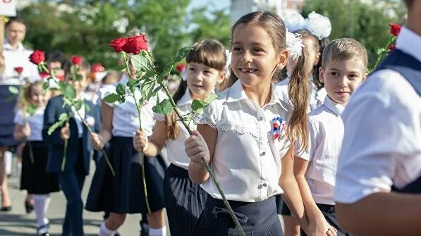
Language is not an impenetrable barrier. English is taught in Russian schools beginning in third or fourth grade, so most citizens under the age of forty speak at least some English.

Slide 36
Public scales are a common sight throughout the country; taxis and private cars are more plentiful than before the Soviet breakup, and taxi rates are negotiable. Birthdays are not celebrated because they are almost ignored; the metro (subway system) is a national prize, clean and efficient; dogs are forbidden in the cities.

Slide 37

Chapter 2
The United Kingdom

Slide 38

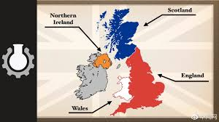
England is a highly urbanized country, with 80% of its population living in cities, and only 2% of the population working in agriculture.
England is physically the largest of the four nations, and it has by far the largest population. This dominance in size is reflected in a cultural and economic dominance too, which has the result that people in foreign countries when they mean the UK.

Slide 39
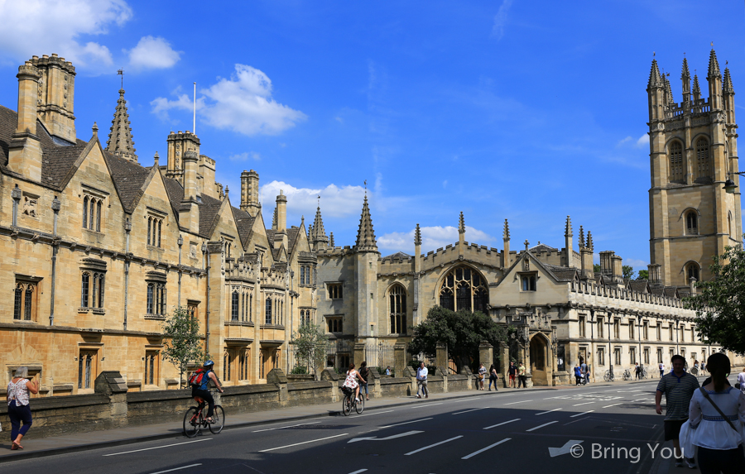
British history has been a history of invasions. Before the first century AD Britain was made up of many tribal kingdoms of Celtic people: a powerful culture originated in central Europe. In 43 AD Britain was invaded by the Roman Empire, and England and Wales became a part of Roman Empire for nearly 400 years. As the Roman Empire came under threat from the east, the Roman armies and Roman protection were withdrawn from Britain, and Britain was again divided into small kingdoms, and again it came under threat from outside, this time from Germanic peoples: the Angles, and the Saxons.

Slide 40
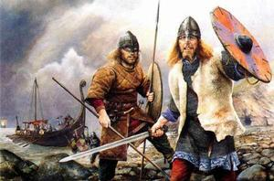
Whether Arthur’s success, legend or not, it did not last, for the Anglo-Saxon did succeed in invading Britain, and either absorbed the Celtic people, or pushed them to the western and northern edges of Britain.
The next invaders were the Normans, from Northern France, who were descendants of Vikings. William of Normandy took the English throne, and became William the First of England. The Tower of London, a castle in the center of London which he built, stills stands today.

Slide 41
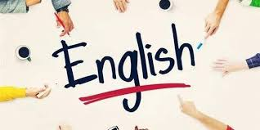

The next three hundred years may be thought of as a Norman (and French-speaking) aristocracy ruling a largely Saxon and English-speaking population. It is this situation which produced another of England’s heroic legends.
Gardening is one of the most popular pastimes in England, and the back garden provides a place where people’s outdoor life at home can go on out of the public gaze.

Slide 42
The next few hundred years following the Norman invasion can be seen as a process of joining together the various parts of the British Isles under English rule. At the same time power was gradually transferred from the monarch to the parliament.

Slide 43
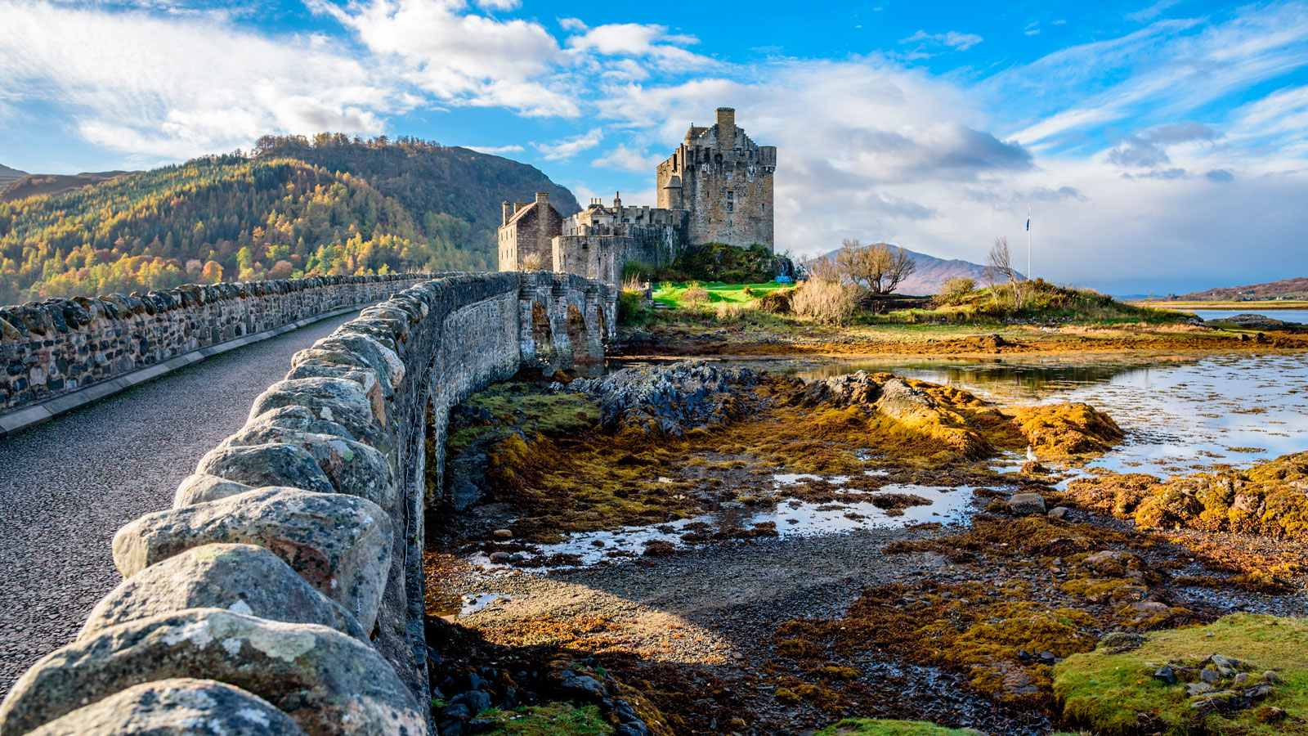
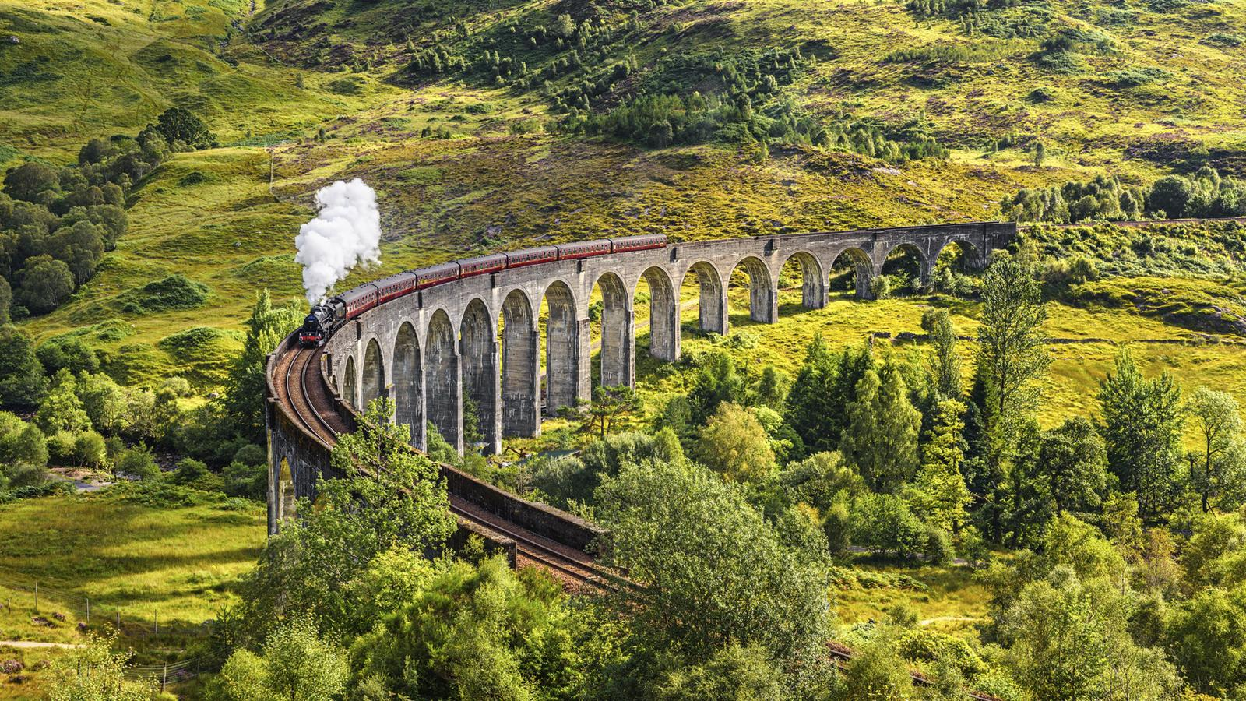
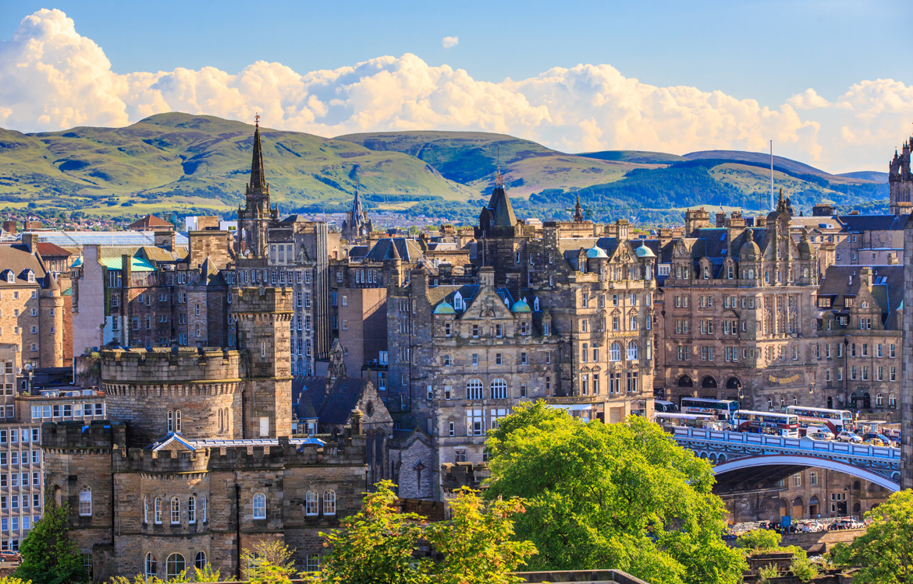
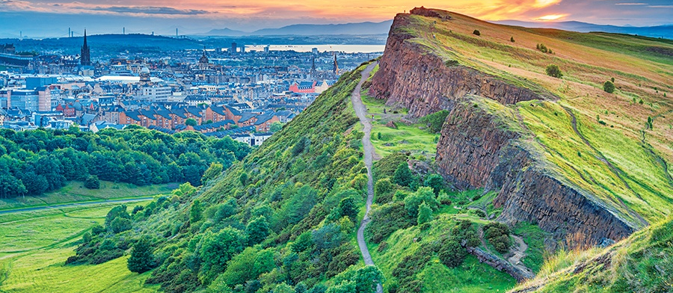
Scotland

Slide 44
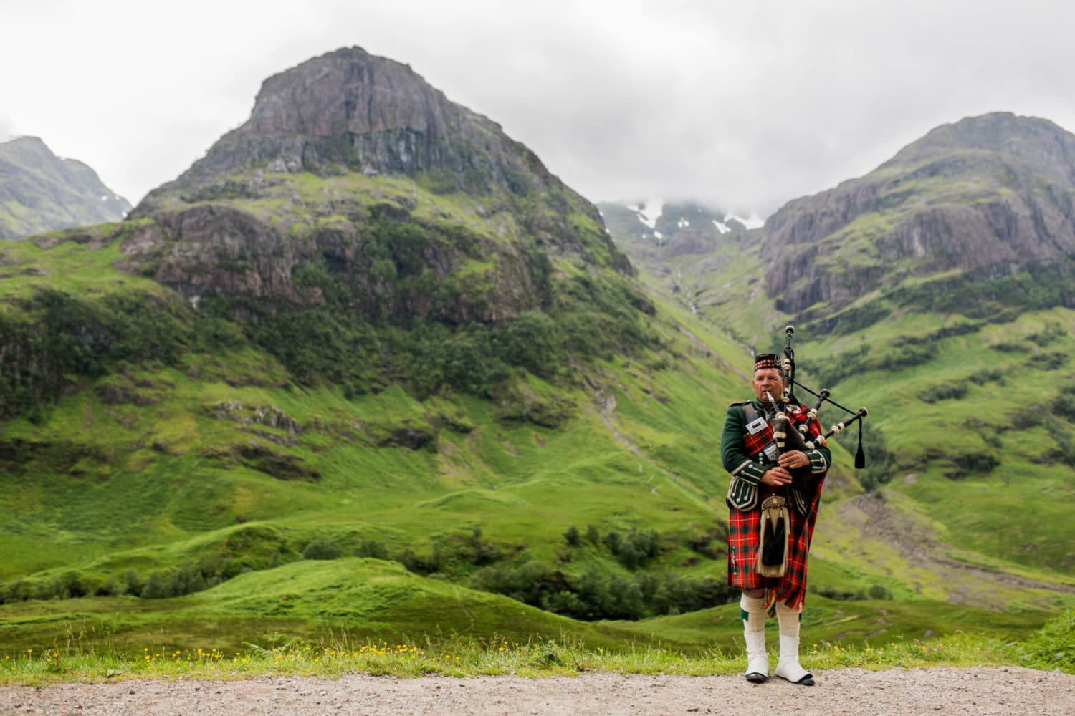
Scotland is the second largest of the four nations, both in population and in geographical area. It is also the most confident of its own identity because along among the non-English components of the UK it has previous spent a substantial period of history as a unified state independent of the UK.

Slide 45
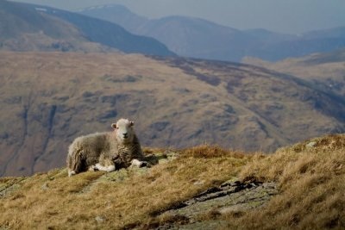
Physically, Scotland is the most rugged part of the UK, with areas of sparsely populated mountains and lakes in the north (The Highlands), and in the south (The Scotland Uplands). The largest city is Glasgow, in the west of this zone.
Scotland’s capital city is Edinburgh, on the east coast forty miles away from Glasgow. It is renowned for its beauty, and dominated by its great castle on a high rock in the center of the city.

Slide 46
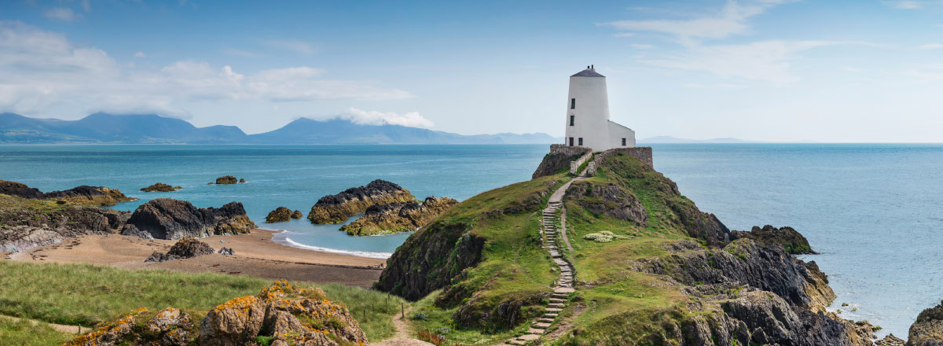
Wales

Slide 47
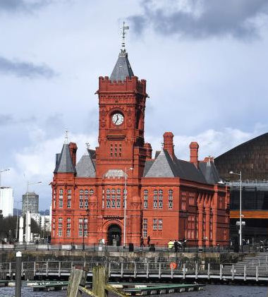
The capital of Wales is Cardiff, a small city of about 300,000 people on the south coast. This southern area was an important element in Britain’s industrial revolution, as it had rich coal deposits. Coal-mining became a key industry for the Welsh.
South Wales has been very successful in attracting investment from abroad to help to create new industries to replace coal and steel.
Wales is the smallest among the three nations on the British mainland, though larger than Northern Ireland.

Slide 48
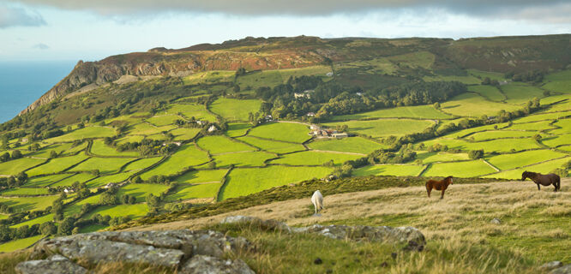
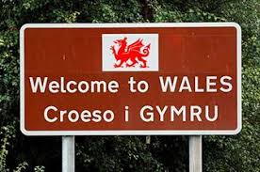
Wales retains a powerful sense of its difference from England. It also retains its own language, Welsh. This is a Celtic tongue completely different from English, spoken by 19% of the population, a much higher proportion of the population than speak Gaelic in Scotland.
It is very close to the most densely populated parts of central England. Though it is hillier and more rugged than adjacent parts of England there is no natural boundary. So Wales has been dominated by England for longer than the other nations of the union.

Slide 49

Like the rest of Britain, before the arrival of the Roman empire, Wales was a land of Celtic peoples, living in a number of small tribal kingdoms. Wales was conquered by the Romans eventually.
Wales was always under pressure from its English neighbours, particularly after the Noman conquest, when Norman barons set up castles and estates in Wales under the authority of the English Crown.

Slide 50

A hundred years after Glyndwr, in 1536, Wales was brought legally, administratively, and politically into the UK by an act of the British parliament. This close long-standing relationship means that modern Wales lacks some of the outward signs of difference which Scotland possesses-its legal system and its education system are exactly the same as in England.

Slide 51
However, Wales is different, and one of the key markers of that difference is the Welsh language-the old British Celtic tongue which is still in daily use. 80% of the Welsh don’t speak the language, and yet feel Welsh.
Since most the Welsh speakers are in the north, this deepens a cultural division between the more populated, industrial south, and the rural north of Wales.
In May, 1999, the Welsh held an election to create their own assembly.

Slide 52




Northern Ireland

Slide 53

C
North Ireland (often called “Ulster” after an ancient Irish kingdom which once existed in that part of Ireland) is the smallest of the four nations, both in area and population. With only 1.6 million people, it is smaller than many Chinese cities. Its capital, Belfast, is a relatively small town of around 350, 000 people, but is much the biggest city in the province.

Slide 54


Physically, it is mostly rural, with low hills, a beautiful lake district in the south-west, and a rugged coastline, which includes its most famous landmark, the “Giant’s Causeway”, a rocky promontory made up of black hexagonal columns formed by cooling lava millions of years ago.
Though Northern Ireland is small it is significant because of the political troubles here.

Slide 55

Legend has it that the giant Finn MaCool built it to cross the sea to Scotland. The nature of its link to Great Britain has been a key element in Northern Ireland’ s history, and remains an issue today.
Apart from the troubles, crime is very low, and even including political violence the murder-rate is much lower than in most American areas.

Slide 56


The Northern Ireland economy has its problems, partly as a result of the troubles discouraging investment, partly as a result of its peripherality in relation to the UK. Its wealth per head is the lowest of any UK region. Nevertheless living costs are also comparatively low, and a standard of living is possible for those of middle to upper incomes which many Londoners might envy.
North Ireland has an active cultural life with many theatres, restaurants, pubs, and museums: its best known poet, Seamus Heaney, won the Nobel Prize for literature in 1995.

Slide 57



History

Slide 58
Until 1921 the full name of the UK was “The United Kingdom of Great Britain and Ireland”, not only “Northern Ireland”, because the whole island of Ireland was politically integrated with Great Britain, and had been since 1801, while Britain’s domination of the Irish dated back centuries before that date. But Irish desires for an independent Irish state were never lost, and one of the key issues in late nineteenth century British politics was a campaign in parliament of what was called “home-rule”-Irish political control of Irish affairs.

Slide 59

However, there was a problem. The majority of Irish people were descendants of the original Celtic people who inhabited the British Isles before the Romans arrived 2,000 years ago. Ireland was not invaded by the Romans, thus they were ethnically distinct from the majority of British people. Adding to this difference was religion: most Irish people remained Catholics, while most people had become Protestants.

Slide 60

Catholics found it harder to get jobs, or to benefit from social programs such as public housing. Understandably resentment grew, and the armed conflict known as the “troubles” developed.

Slide 61



Towards
a solution

Slide 62
In July , 1977 the IRA reinstated their ceasefire, which brought about the resumption of peace talks that September. In April, 1998, the peace talks came to a settlement and peace agreement which allowed citizens of Northern Ireland to vote on a new autonomous parliament and set up their own cabinet. The British government transferred authority to the new parliament in December, 1999, but after three months (Feb., 2000), the autonomy was suspended because the IRA were unwilling to hand over their weapons. In October 2001, the IRA announced their disarmament. It’s a milestone on the way to real peace in Northern Ireland.

Slide 63

Chapter 3
The UK Economy

Slide 64

From 1945 until the present, the story of the UK economy is usually thought of as one of decline. This is understandable but rather misleading, as it has in fact been a period of steady economic growth and rapidly increasing living standards. Britain remains one of the Group of Seven large industrial economies.
Also Britain was the centre of a still vast empire. The UK was second only to the United States in the international economy. Thus Britain was then in an apparently strong economic position, a position it clearly no longer occupies, which indicates some sort of decline.

Slide 65

Firstly the country had gone heavily into debt in order to finance the war, selling many of its accumulated overseas assets and borrowing the large amounts from the United States and Canada.
Secondly, the era of empire was over.
Thirdly, despite the relatively rapid and trouble-free process of decolonization, Britain was still forced to maintain a substantial and expensive military presence in many overseas locations until the process was completed (mostly by the end of the 1960s).

Slide 66
Fourthly, although Britain was quite badly damaged by German bombing during the war, its industry survived comparatively unaffected.
British industry however could continue with its older factories and pre-war products, and given its other economic problem, did so—a problem in the long-term.
A low rate of domestic industrial investment coupled with a very high rate of overseas investment is still a characteristic of the UK economy.

Slide 67


Britain is a lot wealthier and more productive than it was then. The problem is that though it has improved, other countries have improved more rapidly, hence the slide from being the second-largest economy after the United States to be being the sixth, as it is at present.
So, the UK has experienced economic decline, but this decline is relative to some other economies rather than absolute. Nevertheless, this relative failure is a serious cause of concern to the UK governments.

Slide 68


Recent
History

Slide 69

The British economy went through a particularly bad period in the 1970s. The oil price rises at that time led to very high rates of inflation. This caused many workers to strike for more pay. Throughout the 1980s an extensive program of privatization was carried out, with many state-owned businesses joining the private sector. It seemed in some ways to be successful in that inflation came under control and businesses, especially the newly privatized businesses, made profits. The national economy as a whole continued to grow at low rates than its competitors. In the recession 1990-1992, the economy even shrank by 2.3%.

Slide 70

Britain’s membership of the EU has also made it an attractive location for inward investment by companies from outside the EU (especially the U.S. and Japan), of which it has received a larger share than any other EU country. Overall it is second only to the U.S. as a destination for international direct investment.

Slide 71



The Current
UK Economy

Slide 72




National economies can be broken down into three main areas: “primary” industries, such as agriculture, fishing and mining; “secondary” industries, which manufacture complex goods from those primary products; and tertiary industries, often described as services, such as banking, insurance, tourism, and the selling of goods.

Slide 73


Britain’s agricultural sector is small (producing 1.4% of the national wealth)but efficient, producing 58% of UK’s food needs with only 2% of its workforce. Three-quarters of Britain’s land is used for agriculture, with about a quarter of that under crops—wheat and barley are the two commonest. The rest is grazing for animals, including cattle(both dairy and beef), though sheep are the most numerous livestock. The best agricultural land is in the south-east of England.

Slide 74


The fishing industry provides 55% of the UK demand for fish. Scottish ports land the majority of the fish caught.
Energy production is an important part of the UK economy accounting for 5% of the national wealth. Since the 1970s , when oil and gas were discovered under the North Sea, Britain has become a major oil and gas producer, in addition to its older coal mining industry, which now only accounts for about a quarter of energy supplies. This abundance of energy resources means that the UK has become an overall exporter of energy.

Slide 75

In the secondary sector of the economy, manufacturing industry remains important, producing 2% of national wealth. British companies are active in all major fields of manufacturing industry, but are particularly strong in pharmaceuticals.

Slide 76

Like most developed economic Britain has seen a relative shrinking of the importance of secondary industry and a spectacular growth in tertiary or service industries, which now produce 65% of national wealth. Seventy percent of the UK’s workforce are employed in service sector. The financial sector is an important part of this service industry as London is one of the top three financial centers in the world and is the world’s largest foreign exchange market.
Advertising is another major business service in which UK companies are highly successful.

Slide 77



Case Study:
The Aerospace Industry

Slide 78


After those of the U.S. and Russia, the UK’s aerospace industry is the next largest, capable of producing the full range of aerospace products from civil and military aircraft to missiles, satellites, and jet engines. It produces 2% of UK national output, accounting for 8% of manufactured export goods.
The aerospace industry is now profitable, with over 300 companies employing 170,000 people.

Slide 79

British Literature
Chapter4
Chapter4
Chapter 4

Slide 80

Much early British writing was concerned with Christianity: Anglo-Saxons produced beautifully illustrated versions of the Bible: the most famous of these is the Book of Kells, partly written on the Scottish island of Iona. Today it is kept in the library of Trinity College in Dublin, the capital of Ireland.

Slide 81

One of the oldest of these early “old English “ literary works is a long poem from Anglo-Saxon times called Beowulf. The earliest copy dates from 1,000 AD, but there are pieces of eighth century texts in existence. It tells the story of the 6th century Swedish warrior Beowulf and his conflict with a family of dragons.

Slide 82

With the Norman conquest in 1066 Britain entered the Middle Ages (1066-1485), and the language of the royal court became French, so literature of that period was written in French or Latin. But one work from these times often studied today by middle school students is The Canterbury Tales by Geoffrey Chaucer (1340-1400). He was the first court poet to write in English. It is made up of a series of stories told by pilgrims to entertain each other on their way to the important Christian Church at Canterbury in south-east England.
The Canterbury Tales

Slide 83

It is notable for its diversity, both in the range of social types amongst the 31 pilgrims, and the range in style of the stories they tell.
Irish literature in Gaelic has its own early heroic literature: The Ulster Cycle, recorded from the ninth to thirteenth centuries, features the legendary, unbeatable warrior, Chulain, and his effort to defend the northern Irish kingdom of Ulster from the King and Queen of Connaught.

Slide 84

Elizabethan Drama
There was a general flowering of cultural and intellectual life in Europe during the fifteenth and sixteenth centuries which is known as “The Renaissance” (rebirth).
In British culture one of the most successful and long-lasting expressions of this development lay in drama. The first professional theatre opened in London in 1576, and others followed, producing the work of many notable playwrights, including Christopher Marlowe, Ben Jonson, and William Shakespeare.

Slide 85

Marlow was the earliest of this great trio, and his style is thought to have been a great influence on Shakespeare. His most famous play is Doctor Faustus, the story of a man who sold his soul to the devil in return for power.

Slide 86

William Shakepeare (1514-1616) is probably the best-known literary figure in the world, but little is known of his life. He came from a middle-class family in Stratford, but somehow he became a successful playwright and director of a theatre company in London.
Elizabethan drama and Shakespeare in particular is considered to be among the earliest work to display a “modern” perception of the world: full of moral doubts and political insecurities.

Slide 87
The Nineteenth-century Novel
The nineteenth century was a very rich literary period. The early decades saw the great poets of the Romantic movement, such as Keats, Shelley, and Wordsworth. The Romantics saw themselves as free spirits, emphasizing nature, originality, the emotional and personal, rather than the “rational”, in their work.

Slide 88

This spirit of Romanticism also occurred in the novel, notably in Mary Shelley’s Frankenstein (1817), the story of science gone wrong through the disastrous consequences of an arrogant scientist’s (Dr. Frankenstein) attempts to create life. In the process, he only creates a monster.

Slide 89

Jane Austen wrote six novels published between 1811 and 1818. These stories of middle-class women in search of husbands are known for their fine writing and subtle characterization. In the spirit of the eighteenth century, rationality is praised, but in the contemporary spirit of Romanticism, this is balanced with the imaginative and personal. This balance is seen in the title of one of the best-known of her novels: Sense and Sensibility.

Slide 90

The most famous literary family in British history are the Bronte sisters, and they too were influenced by the Romantic movement.
Charlotte Bronte’s Jane Eyre and Emily’s Wuthering Heights being the most successful. Their novels reflect both their local geography-the wild high moors of the Yorkshire hills and their uncertain economic position. Theses writers could be thought of as novelists first and social critics second.

Slide 91

The most famous Scottish novelist, Sir Walter Scott (1771-1832), wrote many novels in the early decades of the nineteenth century. The first were romances concerned with Scottish history, such as Rob Roy and have been influential as being among the first novels which set about realistically recreating whole historical societies.

Slide 92

Twentieth-century Literature
Twentieth-century literature can be broadly divided into two stylistic periods: Modernism and Postmodernism. Both are characterized by a high degree of experimentation.
Modernism in literature can be seen as a reaction against the nineteenth century forms, which can be thought of as assuming understanding between writer and reader.
Modernist writers express the difficulty they see in understanding and communicating how the world works. Modernist writing seems disorganized, hard to understand. It often portrays the action from the viewpoint of a single confused individual, rather than from the viewpoint of an all-knowing impersonal narrator outside the action.

Slide 93

One of the most famous of English Modernist writers is Joseph Conrad. He was raised in Poland, but became a sailor, and ended up as the captain of a British ship. He got British citizenship and settled in England, where he wrote his books in English. They are modernist in their concerns with moral uncertainty: what is right?

Slide 94

Conrad’s most famous novel is Heart of Darkness (1902), a story of a riverboat journey in central Africa. The journey is a symbolic one representing the darkness at the heart of man.

Slide 95


British Holidays
and
Festivals
Chapter 5

Slide 96

Throughout the year the British celebrate many holidays which reflect the religious, historical, social and cultural diversity of their country. Some holidays are celebrated throughout the country and mark important events of the Christian calendar. Other holidays are based on local customs and traditions which reflect the variety of experience in different regions.

Slide 97

Religious Holidays
Because of immigration and changing beliefs, most of the world’s religions are practiced in Britain, with sizeable Hindu, Jewish, Muslim and Sikh communities and numerous smaller groups. The result is that although many Christian festivals are observed they have been adapted to fit the needs of a modern, secular society.

Slide 98

Christmas is the biggest and best loved British holiday. Schools close for the holiday period, as do shops and offices, so people can spend time at home with their families. Christmas is celebrated by most Britons by exchanging gifts and Christmas cards, preparing holiday foods, and decorating homes and workplaces with colored lights, Christmas trees and ornaments.

Slide 99

Another British Christmas tradition is to hear the Queen give her Christmas message to her realm over the television and radio.
A third British tradition, which is also celebrated in countries with British heritages, is Boxing Day, which falls on the day after Christmas. Traditionally, it was on Boxing Day that people gave Christmas gifts or money to their staff or servants. Now that most British people do not have servants, this custom is no longer observed and most people cannot tell you what one is supposed to do on Boxing Day. Boxing Day is a day for visiting, eating, and relaxing.

Slide 100

For Church goes it is Easter, which is the most important Christian festival. Easter commemorates the crucifixion and resurrection of Jesus Christ. It occurs in the spring, when schools and universities close for a break. While Christians attend many church services over the Easter period, for most people the main symbol of Easter is the Easter egg, originally a Christian symbol of new life. Nowadays people give each other chocolate or candy Easter Eggs which are often very large, elaborate and expensive. Rabbits and chicks are also animals traditionally associated with Easter and widely appear in chocolate form around this time.

Slide 101

Christmas and Easter have been adopted and celebrated by non-Christian people who emphasize the secular rather than the religious aspects of the holidays.

Slide 102

National Holidays
One of Britain’s most impressive and colorful festivals happens on the second Saturday in June when the Queen’s Birthday is officially celebrated by “Trooping the Color” around Buckingham Palace in London.
The ceremony derives from old military traditions in which regimental flags were paraded before the monarch.

Slide 103

Holidays in four nations
Many festivals and customs have been invented, adopted and used to serve political or religious functions in terms of conflict. Special days in Scotland and Wales demonstrate their national pride in their unique languages and cultures and remind us that there is much more to the K than “the English” and “England”.
England:
The English do not celebrate their famous writers or battles or patron saints,
although they have all these things. One truly English holiday is Bonfire
Night celebrated in the early autumn.

Slide 104

Protestant politicians decided that Gunpowder Plot had failed because God wanted the Protestants to continue to rule England. Parliament passed a legal act calling for a “Public Thanksgiving to Almighty God” for revealing the plot, to be held on the anniversary of the event. Nowadays, English people still celebrate this event in the traditional way.
In London, the cellars of Parliament are still symbolically searched by candlelight by the Beefeaters (the Royal Guard). The Beefeaters still continue this tradition, with their search of the cellars ending with a drinking session.

Slide 105


North Ireland
North Ireland Catholics celebrate the birthday of the patron saint of Ireland, St. Patrick, on March 17 each year. Patrick was a Catholic bishop who lived in the 5th century and is thought to have brought Christianity to Ireland.
According to popular legend, St. Patrick drove snakes (the Christian symbol of evil) out of Ireland. In another legend, it is said that he used the three-leafed clover, or shamrock, to explain the Christian trinity (Father, Son and Holy Ghost) to the pagan Irish. The shamrock is a popular symbol to wear something green. St. Patrick’s Day is celebrated very enthusiastically by Americans.

Slide 106


Robert Burns’night
Each year Scottish people all over the world celebrate their most beloved national poet, Robert Burns (1759-1796), by holding a Burns Supper on the evening of his birthday (25 January). Burns wrote mainly in the Scots dialect and his poems drew on older traditions of Scottish folk songs and stories and so have a wide popular appeal.
Burns night are celebrated with suppers of haggis and whisky and his poems are recited throughout the evening. A bagpiper enters the dining room, followed by the chef carrying the haggis, who lays it in front of the guest of honor. Then the haggis is punctured with a dagger of sword and Burn’s “Address to a Haggis” is recited.

Slide 107


Halloween (31 October)
Halloween is a Scottish festival that comes from the great feast of the pagan Celts which marked the arrival of the winter half of the year. Halloween is notable for showing the darker, supernatural side of Celtic custom-communion with the dead, mischief, fortune-telling, and masquerades are common practices. Nowadays, the bonfires and costumes are still a part of Halloween, especially for children.

Slide 108


Wales
Wales has some of the oldest and richest literary, musical and poetic traditions in Europe. Poems written in the traditional Welsh language and style are governed by ancient codes and conventions which can be track to the Druids, who instituted rigid rules of compositions to help them to correctly memorize and pass on poems and stories.
This poetic tradition has been celebrated for centuries in eisteddfod, a Welsh word meaning a gathering where people recite verses and sing songs. At the Eisteddfod, tents and pavilions are erected around a big open space: in the different tents competitions are held to find the best choirs, translators, essayists, and poets.

